Slide 1
BacT/ALERT® Field Service Engineer Training
Lesson 4 System Installation
Chapter 4.2 LIS Simulator Overview

Slide 2
Objectives
Discover how the BacT/LINK is utilized by our customers
Understand the basic principles of BacT/LINK
Know how to setup & configure BacT/LINK
Know how to test BacT/LINK connections
Know how to use the LIS Simulator Software

Slide 3
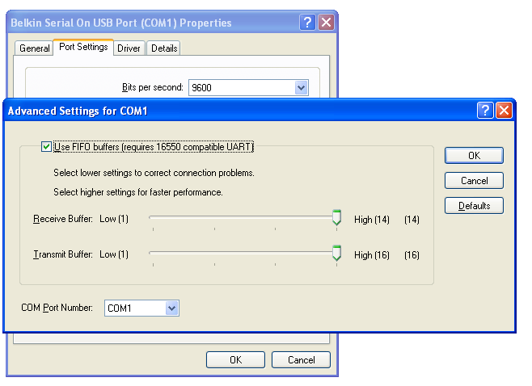

Laptop Configuration
Serial Port on Laptop (older Laptops)
New Laptop no serial port, need USB to Serial Adapter
Set the USB to Serial Port to COMM 1
Connected Belkin USB to Serial Converter
Device Manager

Slide 4
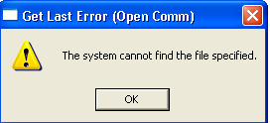

LIS Simulator
Double Click on the LIS icon
Get Last Error Occurs
Caused by the wrong COMM setting in the LIS Simulator
Click OK to the Get Last Error (Open Comm)

Slide 5
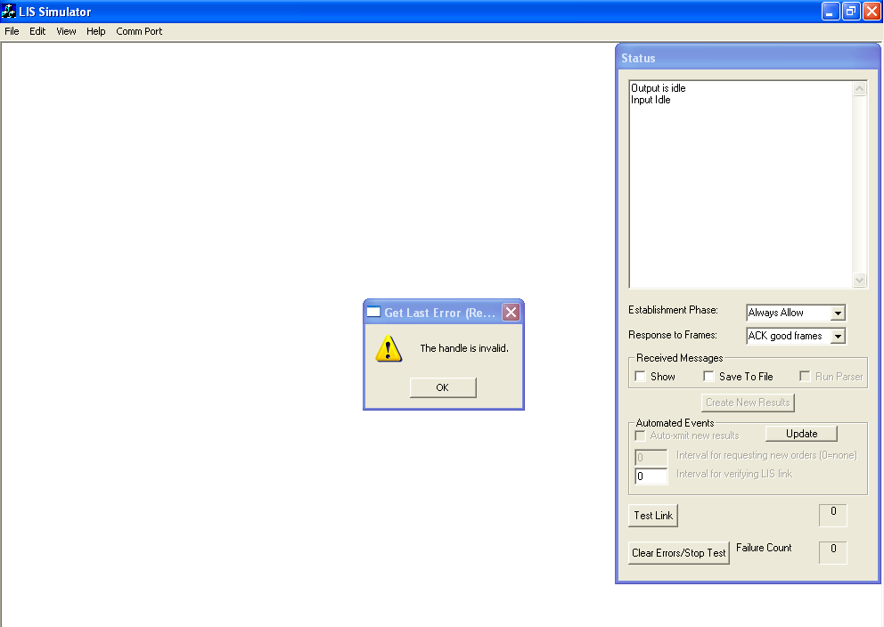
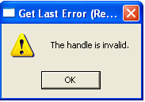
Get Last Error Dialog box
LIS Simulator Software opens
Error message is caused by an incorrect COM Port Settings in the LIS software

Slide 6
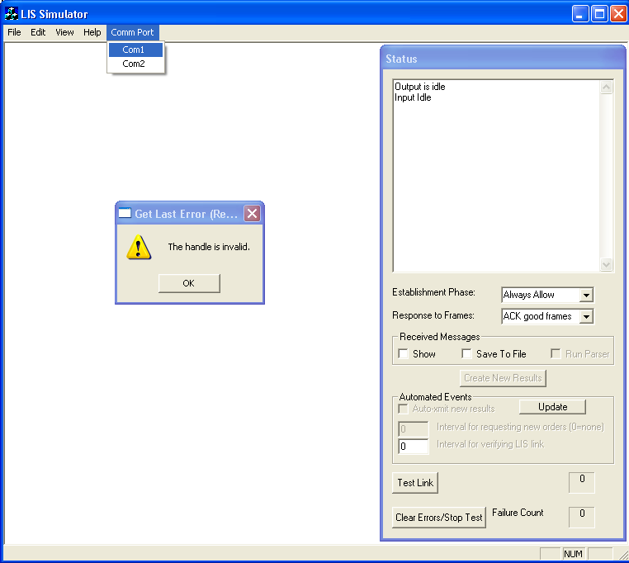
Modify LIS Comm Setting
Modify Comm Port setting to Com1 on the LIS Simulator
Click OK to the Error once Comm setting is modified

Slide 7
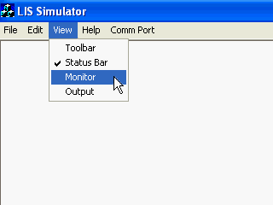
LIS Simulator Monitor
Click View – Monitor to open the LIS monitor screen

Slide 8
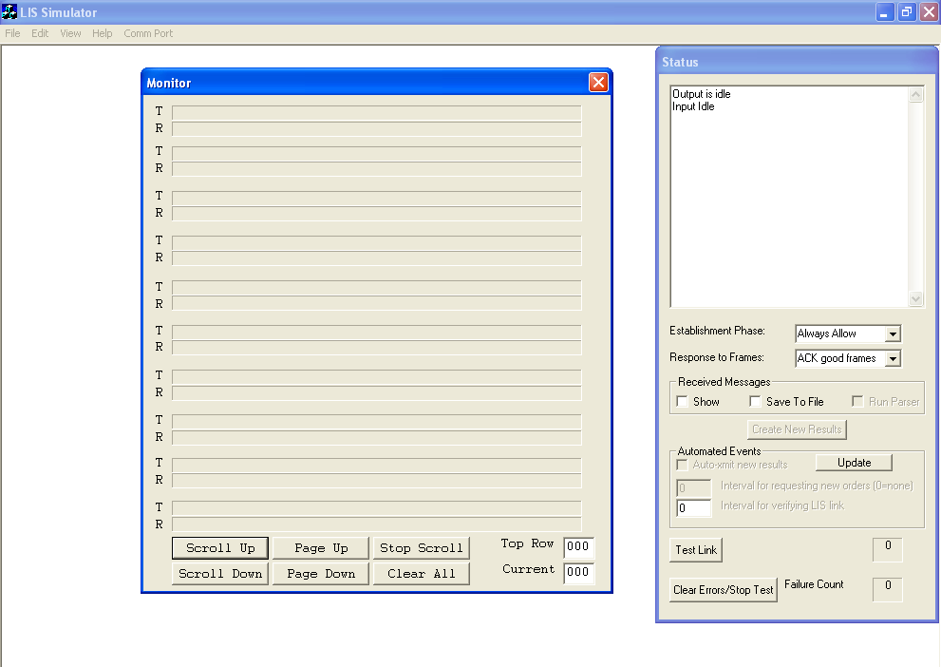
LIS Simulator Monitor Screen
Press Test Link to test the connection
Simulator sends 10 tests links, no fails should occur
View the T and R lines on the Monitor screen

Slide 9
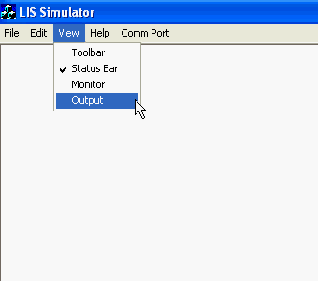
LIS Simulator Output
Click View – Output to open the LIS create message screen

Slide 10
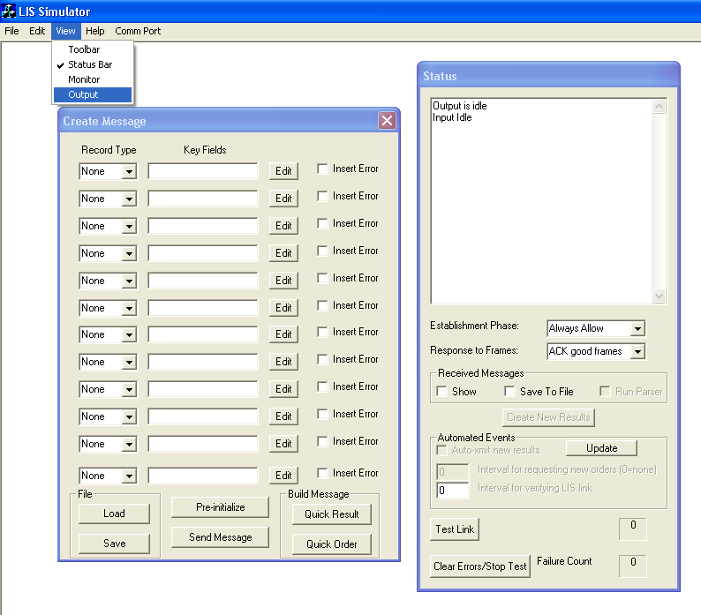

Create Message Screen
Create a message to send to the DBMS or 3D
Click Quick Order button

Slide 11
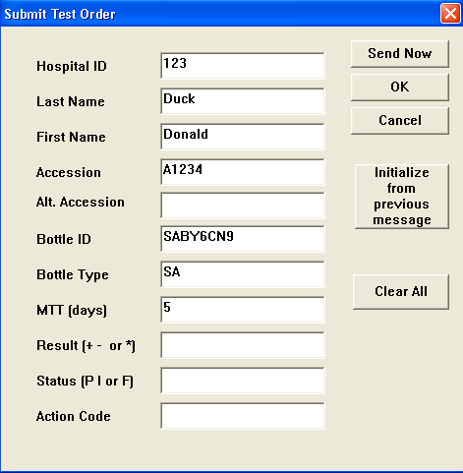
Submit Test Order
Enter Information
Click Send Now
Load Bottle in 3D and
view information

